Slide 1
AMAZON SALES
ANALYSIS REPORT
Giridhar Maurya

Slide 2
Project Description
Approach
Benefits
Help out to make better business decisions.
Help analyze customer trends and satisfaction, which can lead to new and better products and services.
Gives better insight of customers base.
Helps in easy flow for managing resources.
Develop a Report by Extracting-Transforming-Loading of data which contains Sales trend with respect to Year, Month, Quarter and find Some relationships through data to understand and Analyze the Facts.
The primary objective of this Amazon Sales Analysis project is to analyze sales data from Amazon to identify trends, patterns, and insights that can help improve business strategies, marketing efforts, and overall sales performance of the company.

Slide 3
Quick Insight
﻿A quick insight for 2010 to 2017 amazon sales.
1M
Total Sales
137.35
Total Revenue
44.17M
Total Profit
93.18
Total Cost
100
Total Order

Slide 4
Categorized the data
Total Revenue | Total Profit | Total Units Sold | Region | Total Unit Cost | Total Unit Price
39672031.43 | 12183211.4 | 182870 | Sub-Saharan Africa | 6612.39 | 9346.28
33368932.11 | 11082938.63 | 98117 | Europe | 4909.66 | 7237.55
14094265.13 | 4722160.03 | 68325 | Australia and Oceania | 1702.19 | 2449.4
21347091.02 | 6113845.87 | 59967 | Asia | 2635.46 | 3693.9
14052706.58 | 5761191.86 | 48678 | Middle East and North Africa | 1524.5 | 2415.06
9170385.49 | 2846907.85 | 35771 | Central America and the Caribbean | 1104.72 | 1702.21
5643356.55 | 1457942.76 | 19143 | North America | 615.88 | 831.73

Slide 5
Sales Comparison by Region
The sales in Sub-Saharan Africa is maximum of 25733749.52

Slide 6
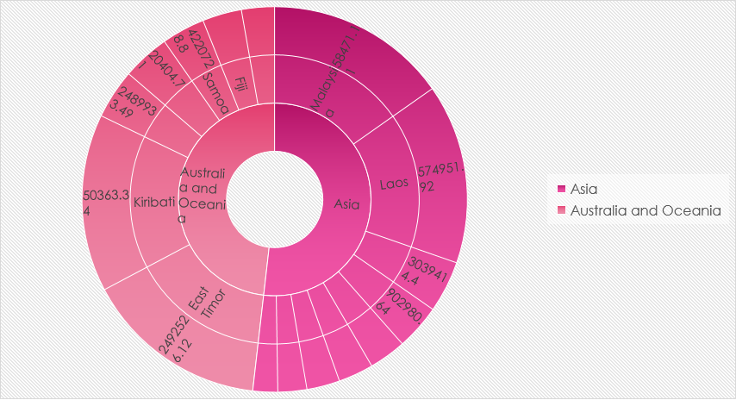
Revenue Categorized By Countries
﻿Asia accounted for 55% of Revenue followed by Australia. The least revenue was accounted by IR followed by CA.

Slide 7
Total Revenue by Sales Channel

Slide 8
Conclusion
1. In Sub-Saharan Africa Total unit sold is 182870 which is highest.
2. Asia accounted for 55% of Revenue followed by Australia. The least revenue was accounted by Iran.
3. The sales in Sub-Saharan Africa is the highest and lowest in Central America.
4. Total 52 % of revenue coming from offline sales.
5. Only 42 % of revenue generating from online sales.
6. 57.59 % of critical order is done offline whereas 42.41 % done online

Slide 9
Thank You

